Slide 1
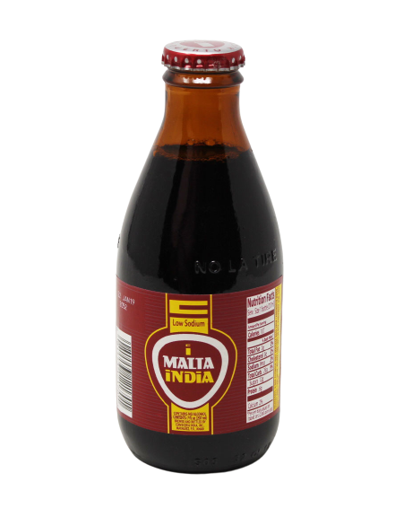
Modeling the Relationship Between Drug Concentration and Cell Viability
Module #5:
2022 Replicathon at the University of Puerto Rico, Río Piedras Campus
Malta India Group
David Hernandez, Laura Benítez, Melissa Lozada,
Taliana Salcedo, and Andrea Corretjer
June 20-21, 2022

Slide 2
Exploratory Data Analysis
How many cell-lines are contained in the data?
Unique cell lines: 288
How many viability data points are within the
expected range according to the definition of viability (e.g. above 0
and below 100)? Try to come up with explanations about
the values that are out of range. Are these due to technical
issues? Biology?
Viability data points within range: 27626
viability score< 0 = technical error, viability score> 100= cell proliferation.
Notes:
Q’s:
How many viability data points are within the
expected range according to the definition of viability (e.g. above 0
and below 100)? Try to come up with explanations about
the values that are out of range. Are these due to technical
issues? Biology?

Slide 3
Introduction Questions
How is viability measured for cell lines?
Why might we (falsely) observe a cell viability
response in a cell line experiment?
Use of markers to observe metabolic and enzymatic activity
Healthy cells convert it to an orange dye through mitochondrial enzymes
XTT Assays
Bacterial contamination
Errors in cell line cultivation and celular variability
Human error when obtaining results
Varied use of different scientific reproducibility tools

Slide 4
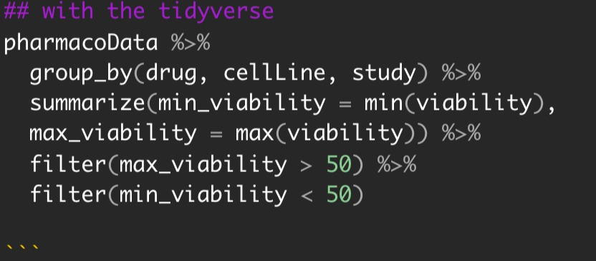
Analysis
Drug–Cell Line Combinations
& Viability Responses
By filtering which drug-cell line combination, out of the 43k used, has a viability score OVER 50%, we can obtain those with a viability score BELOW 50%.
1,640 Drug-Cell Line Combinations
This can be used to obtain our IC50 values.
Notes:
Part of analysis question 1

Slide 5
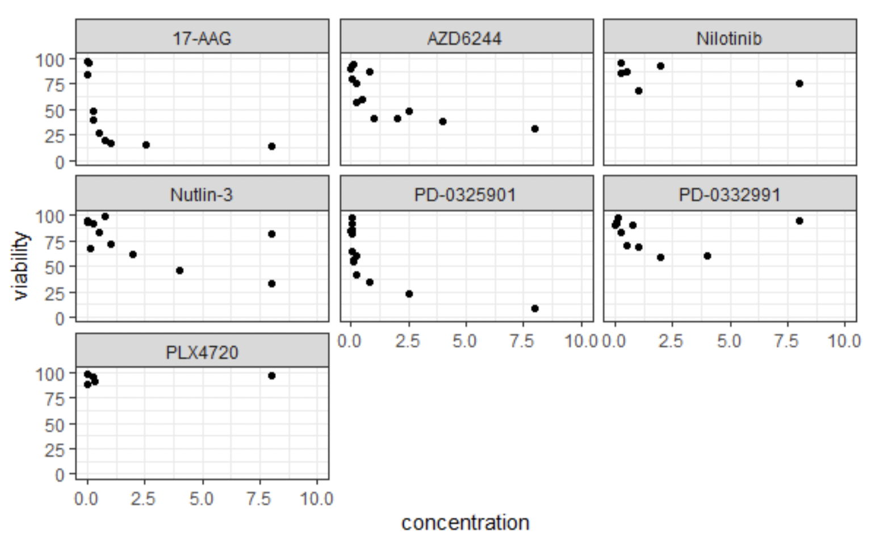
Analysis
Drug–Cell Line Combinations
& Viability Responses
22RV1
Shows resistance to the drug
No trend! Fewer data used
Higher drug concentration = less cell-line viability
Notes:
Part of analysis question 1
Different interpretation

Slide 6
Analysis
IC50 = Half (50%) Maximal Inhibitory Drug Concentration
By normalizing de IC50 values obtained from each drug-cell line combination, we can observe the values at the same concentration to evaluate effectiveness and toxicity.
 | 17-AAG | AZD6244 | Nilotinib | Nutlin-3 | PD-0325901 | PD-0332991 | PLX4720
Raw Data IC50 Values | 0.3 µm | 2.5 µm | 0 µm | 3.9 µm | 0.2 µm | 0 | 0
Normalized IC50 Values | 0.30 µm | 0.31 µm | 0 µm | 0.39 µm | 0.303 µm | 0 µm | 0 µm
Notes:
Part of analysis question 1
Using different values of drugs leads to different results!

Slide 7
Analysis
Nutlin-3
0.39 µm
AZD6244
0.31 µm
1st Most Effective
17-AAG
0.30 µm
PD-0325901
0.303 µm
2nd Most Effective
3rd Most Effective
AUC = Area Under the Activity Curve
Helps us measure performance levels
between models (such as drug effectiveness!)
Higher IC50 correlates to a lower AUC and vice versa.
Notes:
Part of analysis question 1
Normalize to 1 (SIMILAR LEVELS)
Discuss toxicity

Slide 8
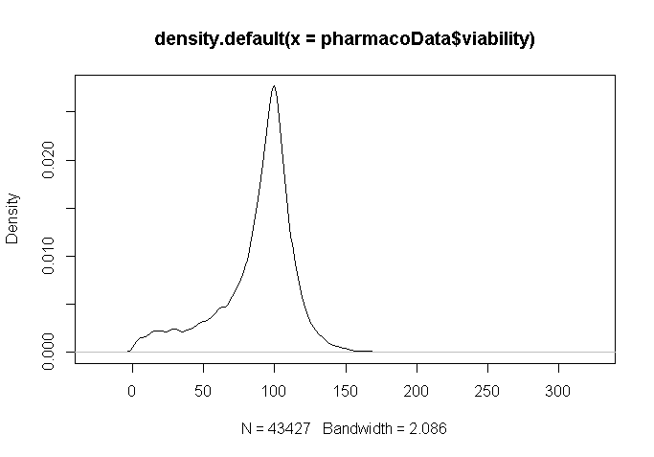
Analysis
Drug–Cell Line Combinations
& Viability Responses
Majority of the cell-lines have 100% viability!
Density curve for cell line viabilities
Notes:
Part of analysis question 1

Slide 9
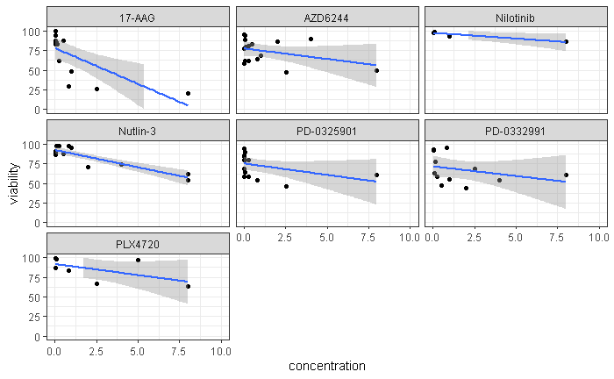
Analysis
Linear Regression Models of Drug Responses
Notes:
This is the analysis question 2

Slide 10
Overall Findings
Analysis conclusions
Level of concordance between GDSC and CCLE
Important considerations
Challenging parts
Using reproducible-friendly scientific tools
Using already-established statistical models/values i.e. IC50, EC50
Running the codes and working with R for a first few times
Learning about IC50 and how to regulate the values obtained
Replicability of the two studies
Contrast in concordance
Inconsistency is due to the use of different values (concentrations of drugs) lead to different results

